Slide 1


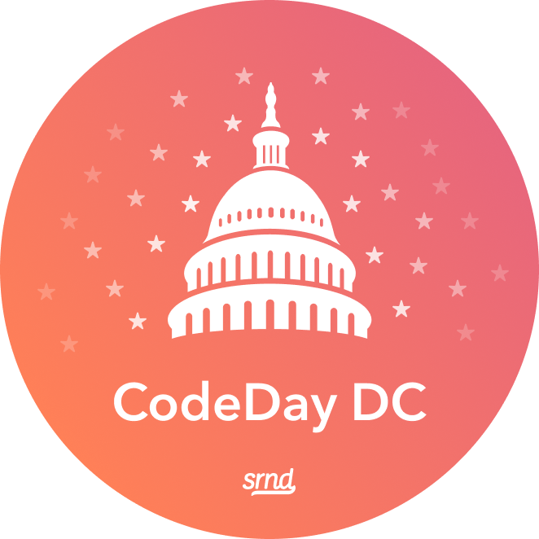
Discord Bots w/ Discord.js
+
And other funny jokes you can tell yourself

Slide 2
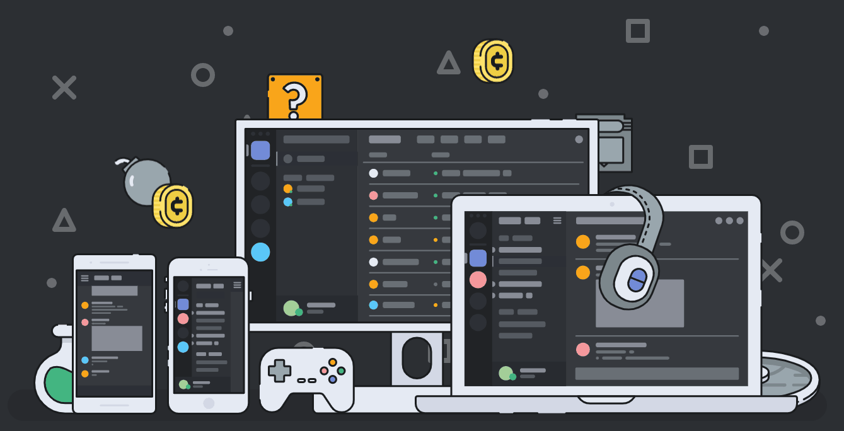
Discord?
A free communication platform, marketed towards gamers
Create & join communities from all over the world

Slide 3


JavaScript? NodeJS?
Programming language originally designed for browsers
NodeJS implements JavaScript server-sided
Thank you NodeJS, VERY COOL

Slide 4

Discord + JavaScript = Discord.js
Open source JavaScript library for Discord
One of the most supported and implemented frameworks for the Discord API
https://discord.js.org/

Slide 5
How do I begin?
Calm down I’ll show you in a second

Slide 6
1.) Setting up the Environment
There are a few things we need to set up:
An IDE / Editor
VSCode
Atom Editor
IntelliJ IDEA / WebStorm
Notepad
… or anything you’re comfortable coding with!
NodeJS Environment
NodeJS
Discord.js

Slide 7
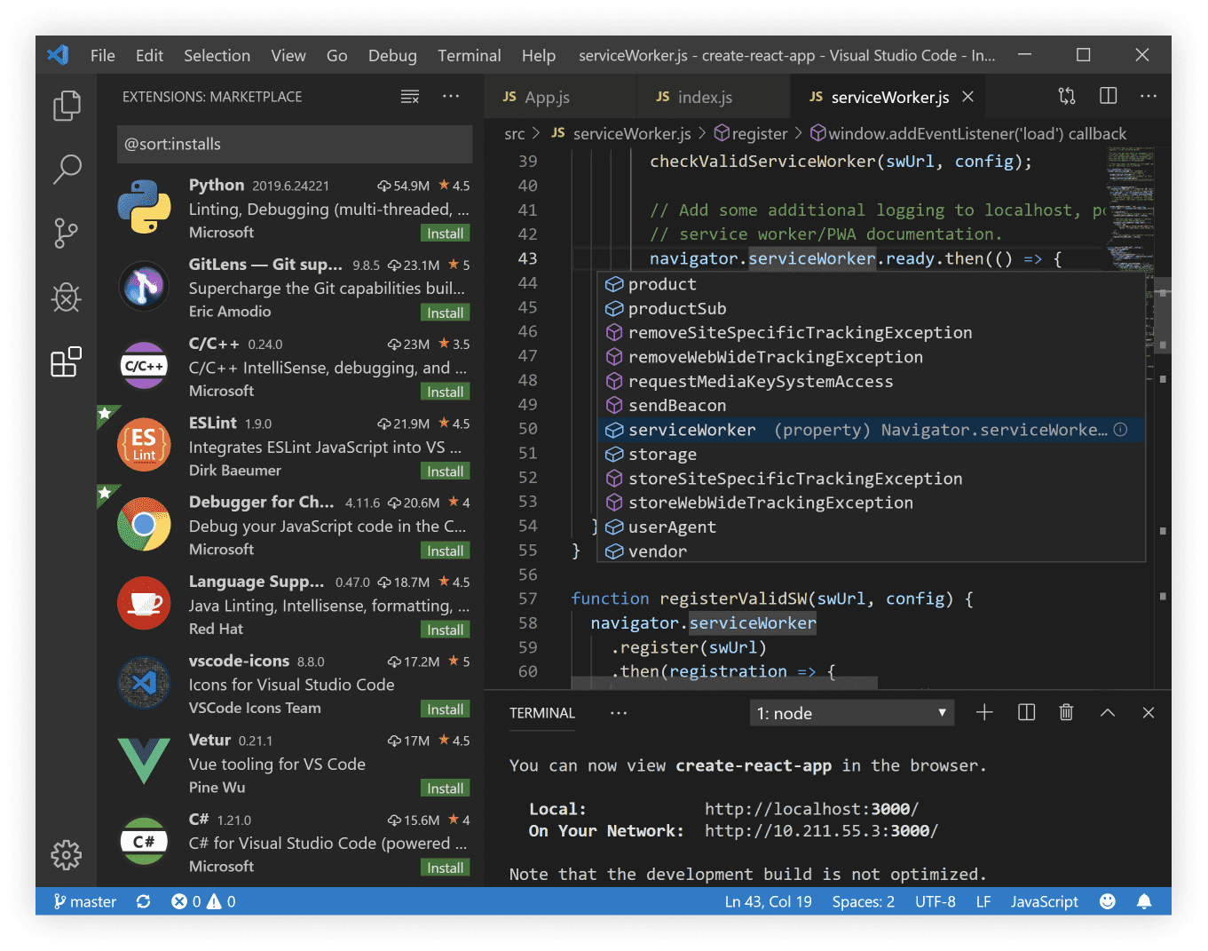

1.) Setting up the Environment
For this workshop, we’ll be using VSCode.
https://code.visualstudio.com/

Slide 8
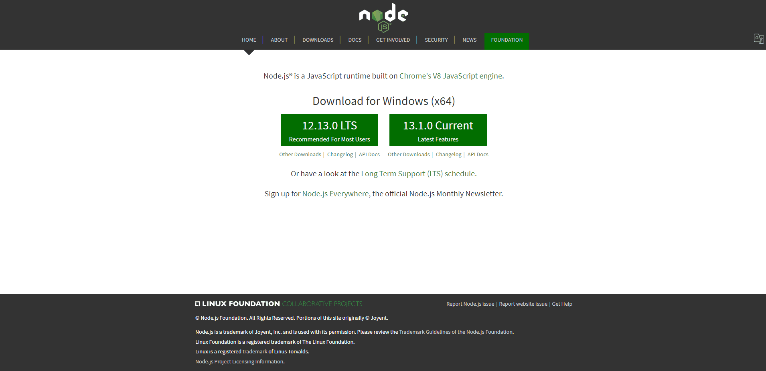
1.) Setting up the Environment
Install NodeJS (for windows)
https://nodejs.org/
Download & run the installer for NodeJS (either version is fine)
Spam the next button until it installs

Slide 9
1.) Setting up the Environment
Create a folder for your bot
Open a Terminal / Command Prompt in the folder
In Windows, SHIFT + right click in the folder
Click “Open Powershell window here”
Run the following commands:
npm init
npm install --save discord.js
Create a file that will contain your bot code
I like to use src/bot.js

Slide 10
2.) Creating a Discord Application
Sign up for Discord if you don’t have an account already!
https://discord.gg/
Join the official workshop server!
https://discord.gg/VUR7Wqd
Visit the Developer Portal to start creating your bot application!
discord.gg/VUR7Wqd

Slide 11
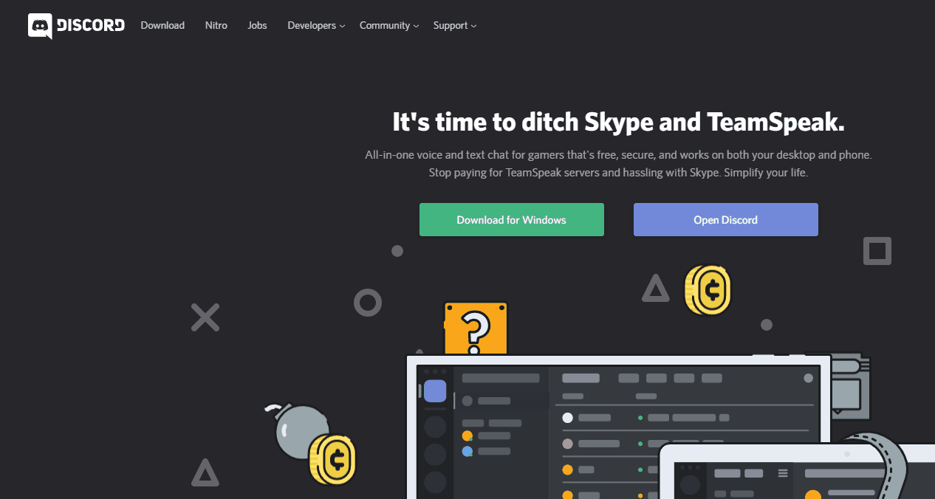
Visit the Developer Portal

Slide 12
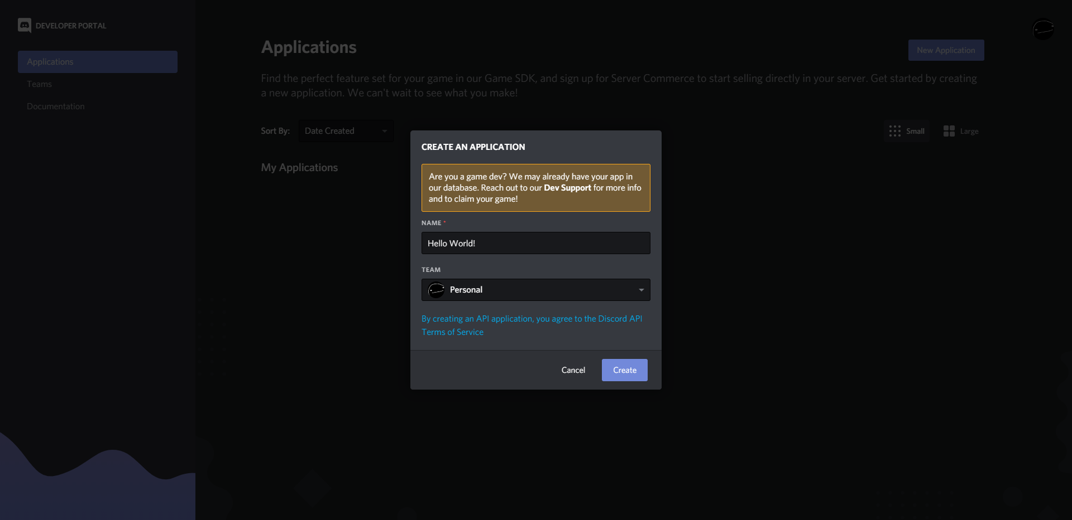
Create an Application

Slide 13
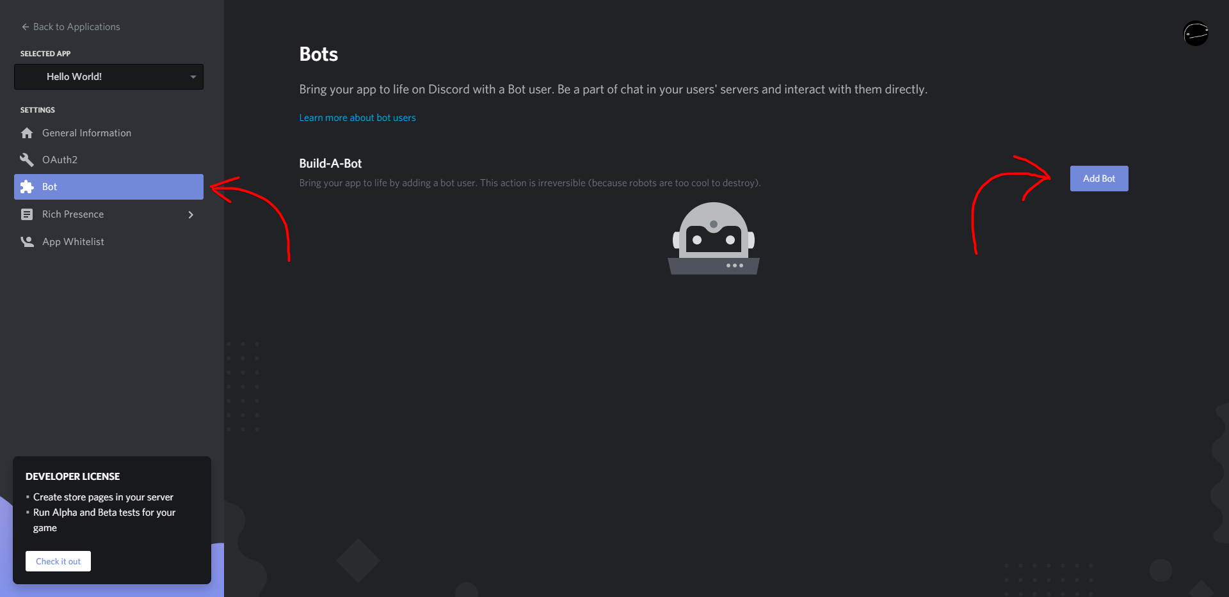
Add a Bot to the Application

Slide 14
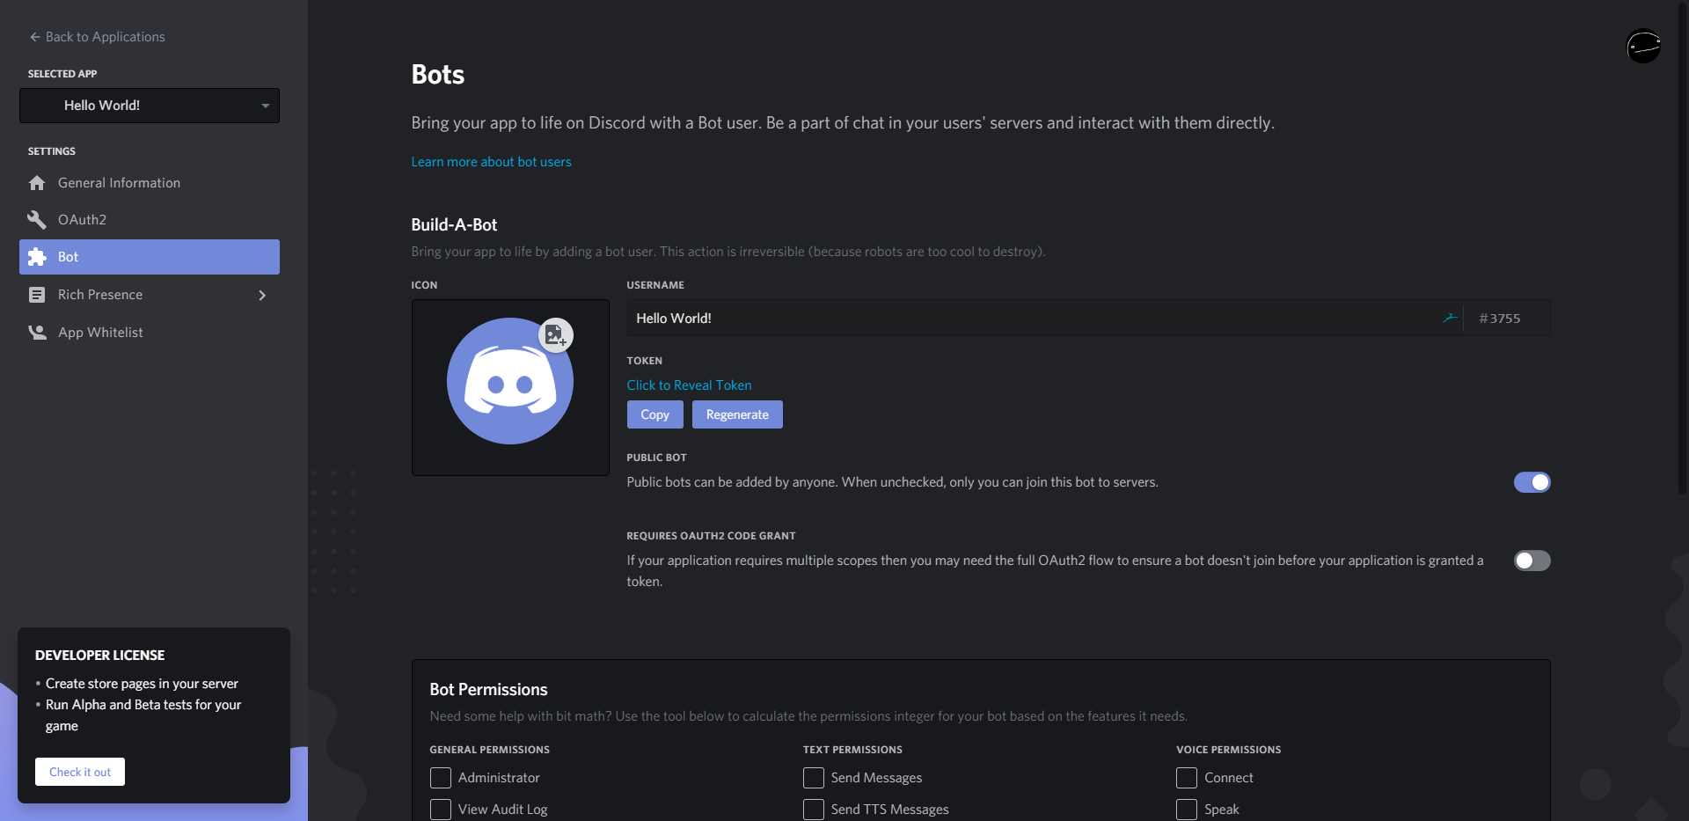
Add a Bot to the Application

Slide 15
Make sure you copy over your bot token! It’s the password to your bot.
With that said, DO NOT share your bot token with anybody! If anybody gets your bot token, they can TAKE FULL CONTROL OF YOUR BOT!
that wouldn’t be fun lol

Slide 16
Now, let’s get coding!
Let’s look at some starter code.

Slide 17
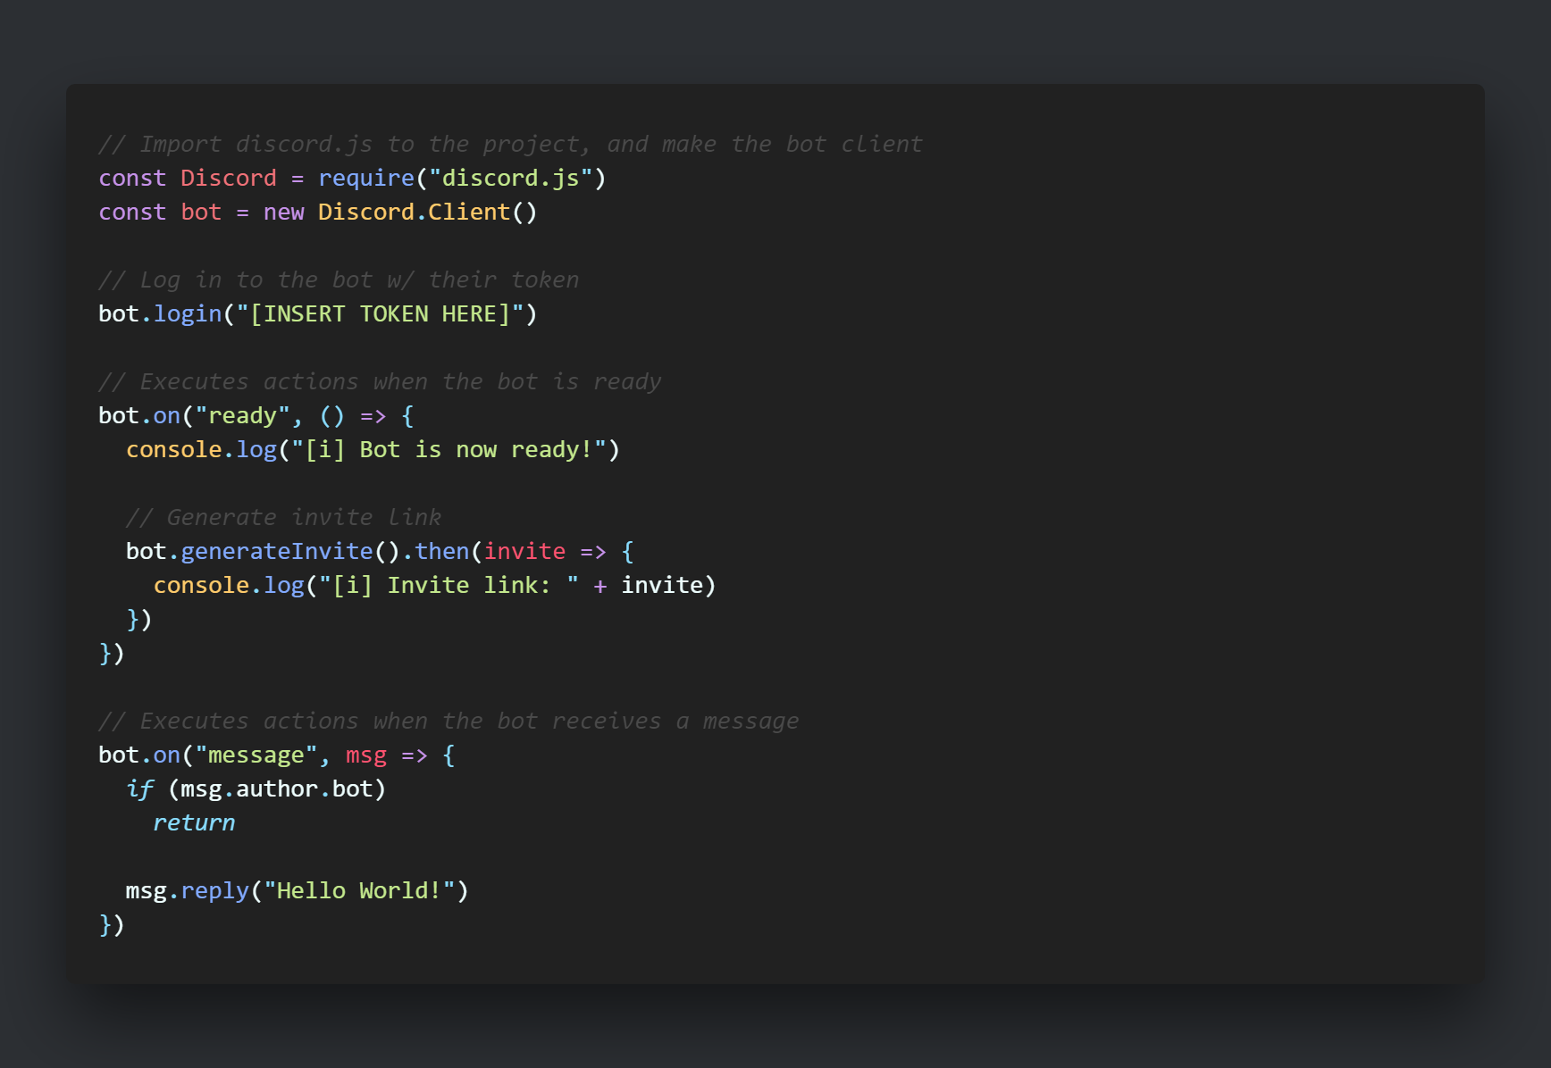
Hello World!

Slide 18
Testing + Running Your Bot
Just like users, bots need to join a server before they can interact with anything in it.
Bots can’t use normal invite links. Instead, we authorize bots into servers using OAuth.
The code automatically generates an invite link when it starts
You can send this link to other server owners who can authorize your bot, or even use it yourself!

Slide 19
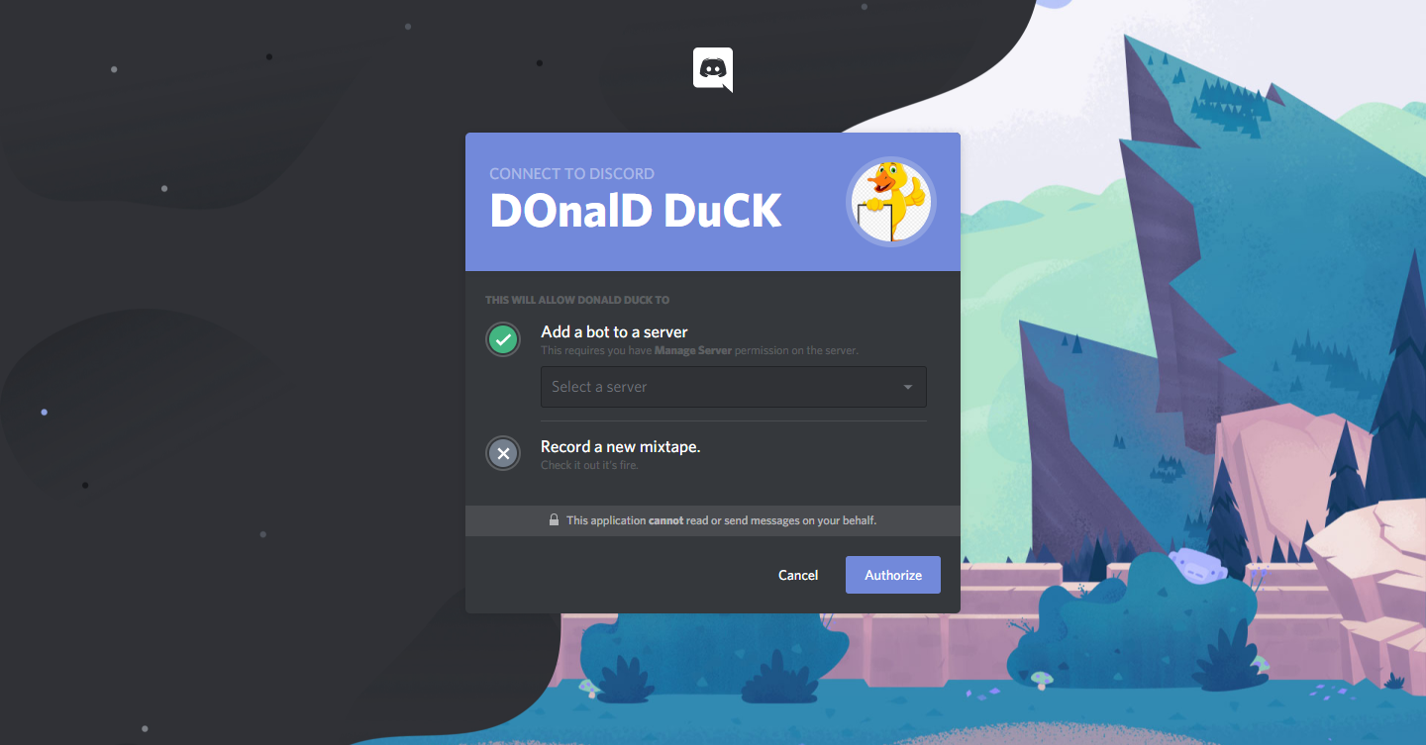
Testing + Running Your Bot

Slide 20
Asynchronous Programming
In JavaScript, code doesn’t necessarily run in order
Web requests take time!
JavaScript doesn’t want to wait until actions finish before starting – this causes the application to feel slow and delayed.
The solution is asynchronous programming.
Async functions run on separate threads, allowing the main code to continue running while a function waits for a response
In JavaScript, we declare callback functions that are executed once the action finishes.
Ex: You order a Starbucks, continue with your day, and pick it up when it’s ready

Slide 21
Event Handlers
99% of what we do with Discord bots depends on event triggers
Event handlers handle these events for us:
bot.on(“ready”) -> Runs code when the bot is ready
bot.on(“message”) -> Runs code when the bot receives a message
bot.on(“guildMemberAdd”) -> Runs code when a user joins the guild
bot.on(“guildMemberRemove”) -> Runs code when a user leaves the guild

Slide 22
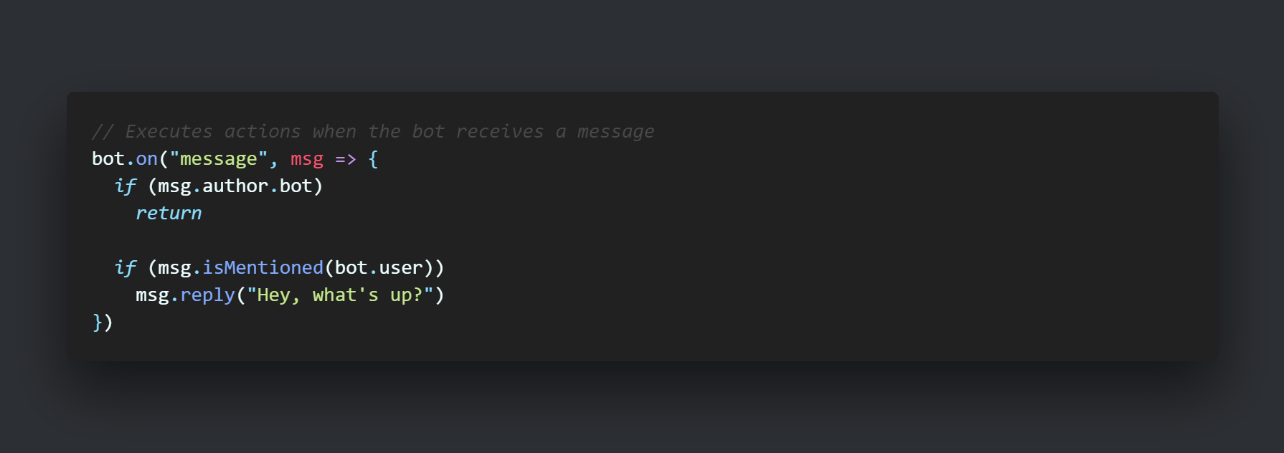
Replying to Users

Slide 23
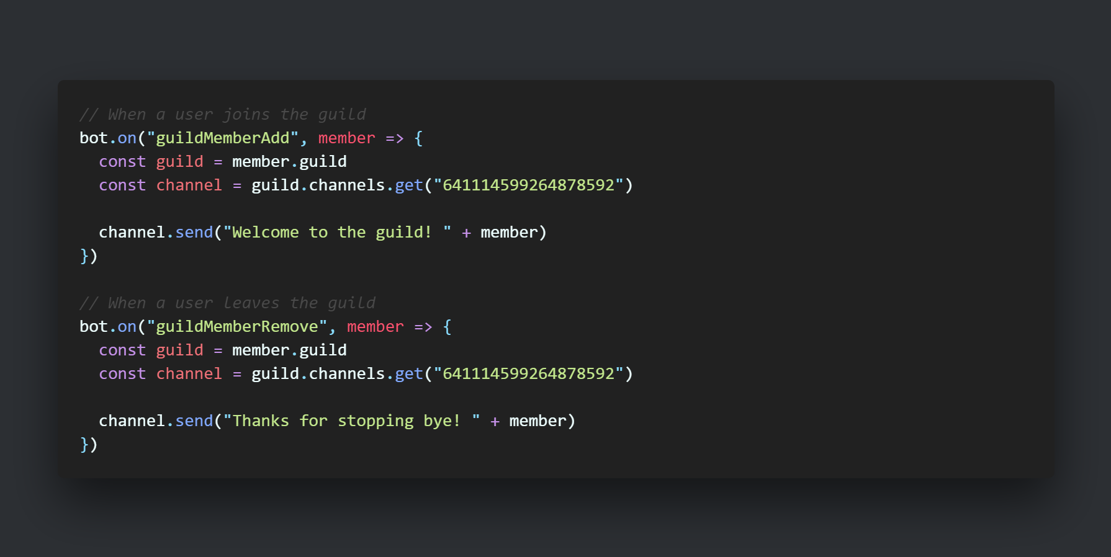
Greetings + Farewells

Slide 24
Commands & More
Let’s gooooo gamers

Slide 25
Commands
Commands are just messages handled differently!
When we detect that a message starts with a prefix, we perform an action:
!ping -> Responds w/ the message “Pong!”
!time -> Sends the current time to the channel
!remindme [duration] [message] -> Reminds the user w/ the message after a certain amount of time
Prefixes are variables!
Some bots use more than one character (t@, $$, t!)
It’s important to make it easy to change the prefix in case you don’t like it.

Slide 26
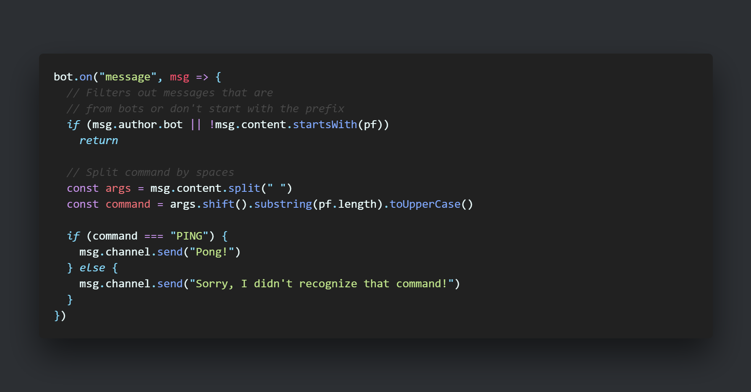
Ping Pong

Slide 27
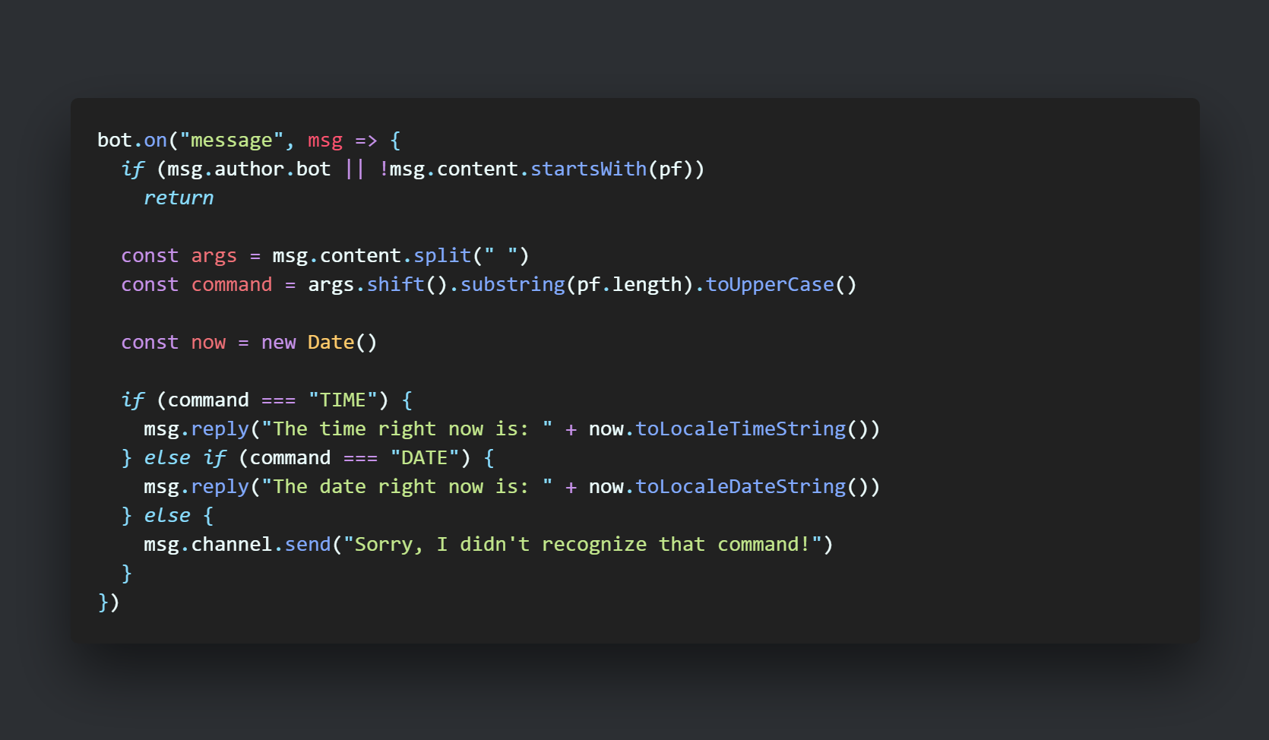
Time + Date

Slide 28
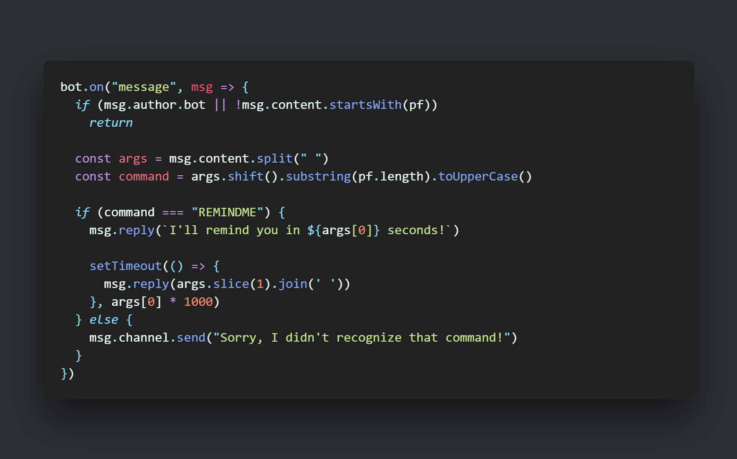
Remind Me

Slide 29
Extra Projects
This text is here to make it seem like I know what I’m talking about

Slide 30
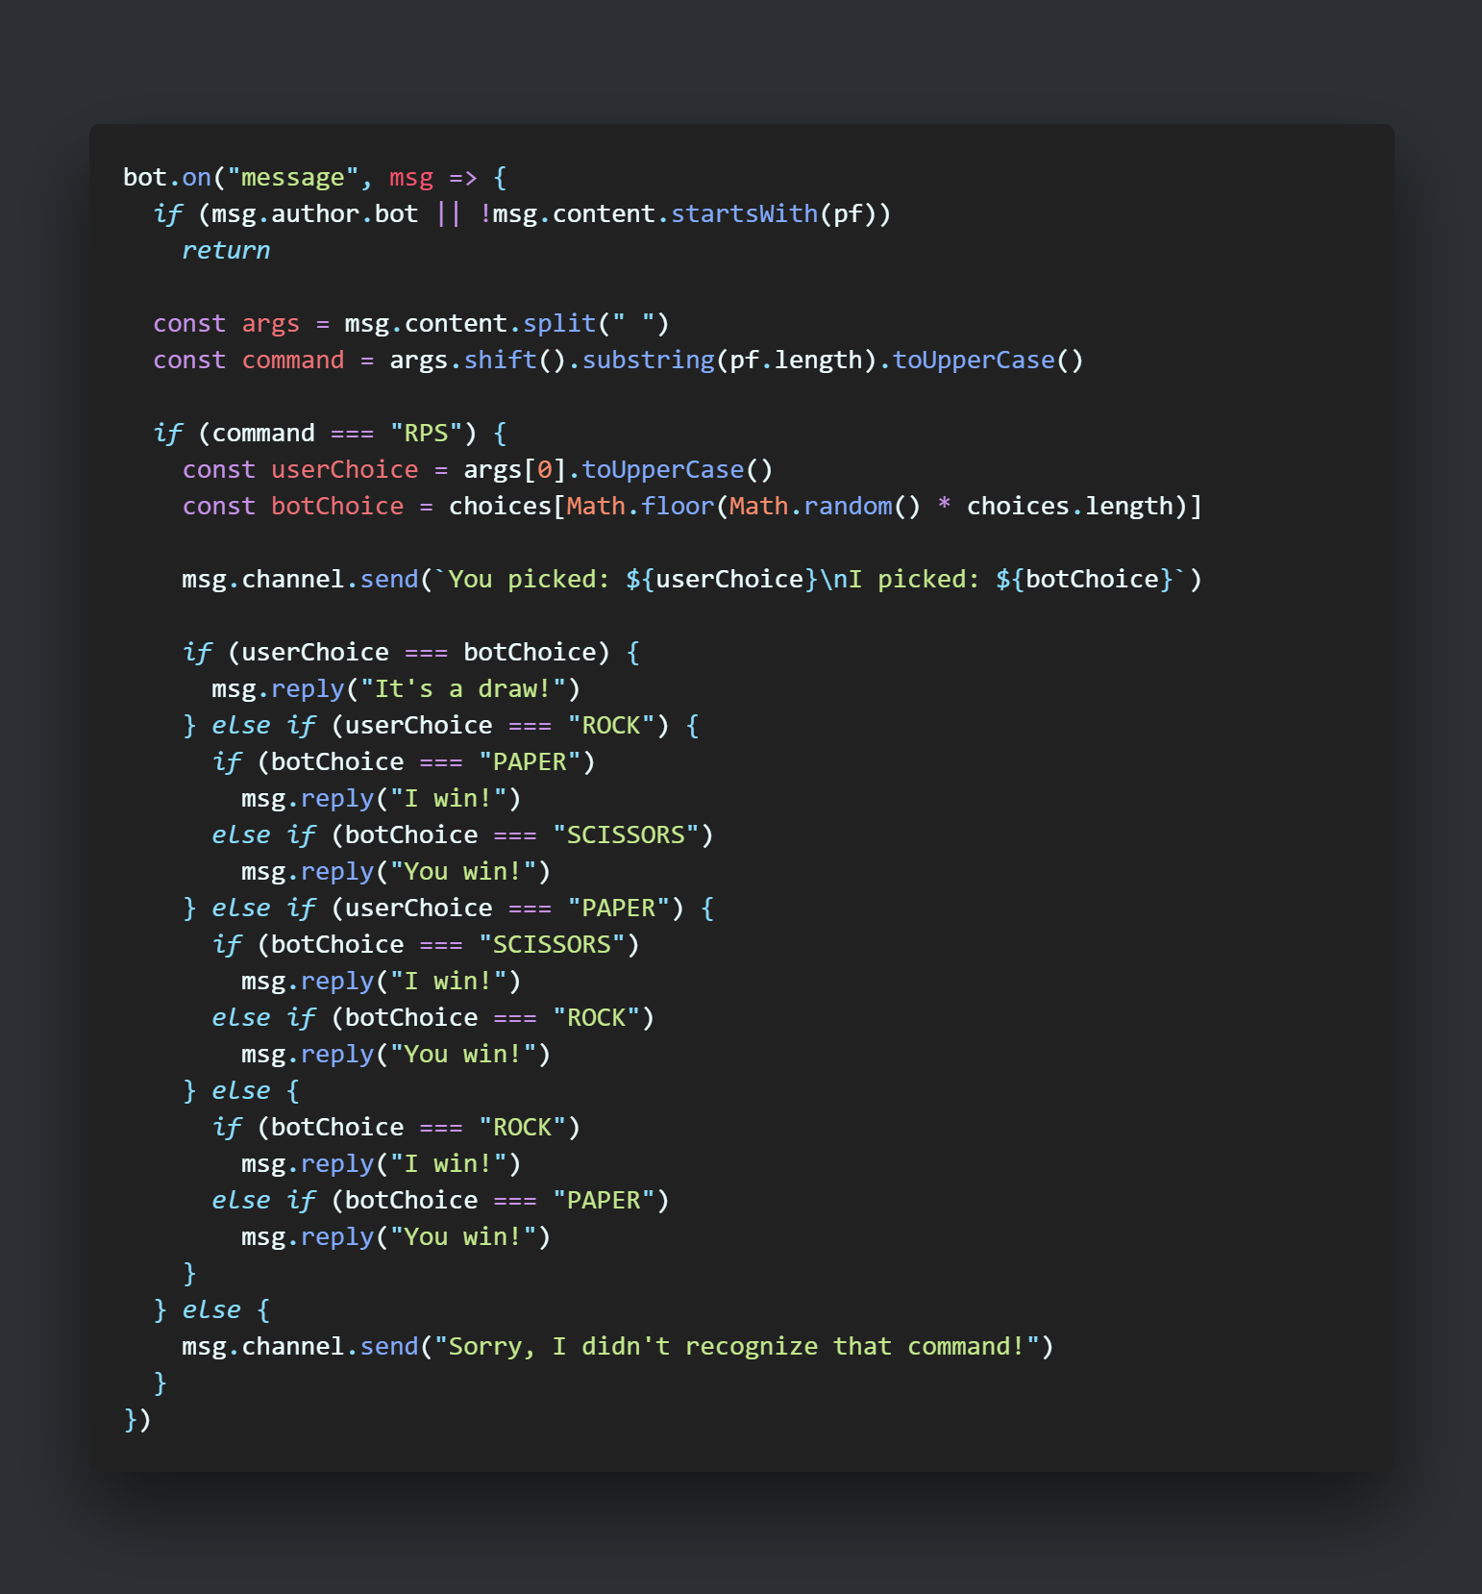
Rock, Paper, Scissors

Slide 31
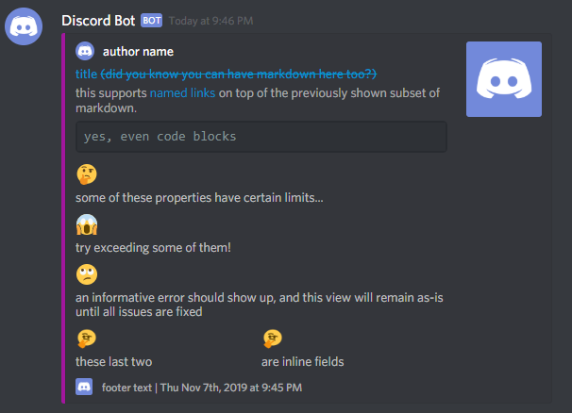
Rich Embeds
Rich Embeds are basically better messages.
They contain many nifty little features:
Cool little sidebar colors
Fields for key + value pairs
Support for embedded images and icons
Author + Footer fields
… and more stuff that I can’t remember rn

Slide 32
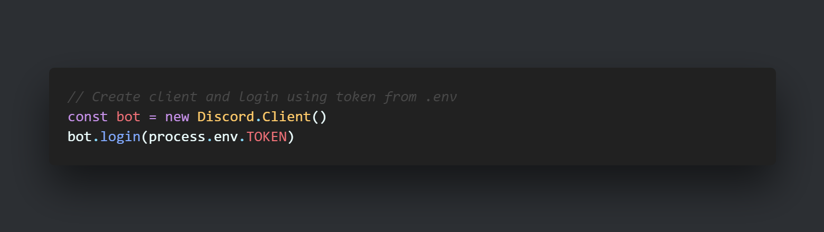
Dotenv

Slide 33
What’s next?
We’re almost done :(

Slide 34
What’s next?
If you’re interesting in finding out more about discord development, check out these other cool communities:
DiscordJS community – https://discord.gg/djs
Discord API – https://discord.gg/discord-api
You can find the workshop on my GitHub:
https://github.com/cf12/codedaydc-discordjs-workshop
The repo contains all the example code, this PowerPoint, as well Donald Duck’s code
Reach out to me on my website: https://cf12.org/

Slide 35
“The reputation of a thousand years may be determined by the conduct of one hour.”
- Japanese Proverb

Slide 36
thanks for coming to my TED talk lol
no seriously, thank you :) uwu

Slide 37

Enjoy the rest of CodeDay!

